Slide 1
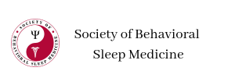
Important Notes
CME/CEUs Certificate
Society of Behavioral Sleep Medicine6th Annual Scientific Conference and Graduate/Postgraduate Course
Chicago, IL
September 12 - 15, 2024
How to Get Your Certiﬁcate
Go to sbsm.cmecertiﬁcateonline.com
Click on the 6th Annual Scientiﬁc Conference and Graduate/Postgraduate Course link.
Evaluate the meeting.
Print, download, or save your certiﬁcate for your records.
If you lose your certiﬁcate, or need help, go to help.cmecertiﬁcateonline.com
Access to Presentations, Poster Abstracts, Conference Agenda
https://behavioralsleep.org/index.php/2024-presentations
Link active 9.11.2024 at 8:00 pm eastern
time

